Slide 1
Fitness Buddy
CAPSTONE PROJECT
Presented By:
Name: Misbah Ul Islam
College: South Asian University, New Delhi
Department: Computer Science and Engineering

Slide 2

OUTLINE
Problem Statement (Should not include solution)
Proposed System/Solution
System Development Approach (Technology Used)
Algorithm & Deployment
Result (Output Image)
Conclusion
Future Scope
References

Slide 3
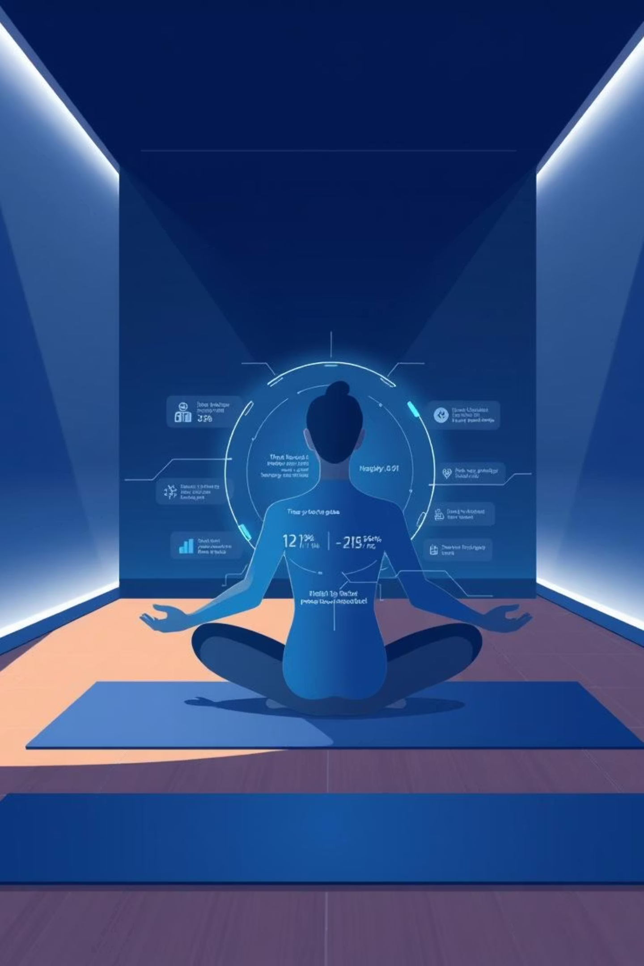
Fitness Buddy: Your AI-Powered Wellness Coach
Transforming personal health management through AI-driven personalization and motivation.

Slide 4
Problem Statement
In today’s fast-paced world, many individuals struggle to maintain a healthy lifestyle due
to lack of personalized guidance, time constraints, and inconsistent motivation. Traditional fitness
solutions often require expensive subscriptions, in-person consultations, or rigid schedules that don't
adapt to personal preferences or daily routines.
There is a growing need for an accessible, friendly, and intelligent virtual assistant that can provide on demand fitness advice, healthy lifestyle suggestions, and basic nutrition guidance—all tailored to
individual needs and available at any time.

Slide 5
Addressing Key Fitness Challenges
Fitness Buddy provides an AI-powered conversational coach that empowers users to improve their health by offering personalized workouts, motivational support, healthy meal ideas, and habit tracking.
Busy Schedules
Limited Access
Lack of Guidance
Tailored workouts fit into any demanding routine.
Home-based routines eliminate the need for a gym.
Personalized AI coaching provides expert support.

Slide 6
Core Components of Fitness Buddy
User Profiling
Nutrition Guidance
Collect fitness level, goals, preferences, and health limitations.
Simple, nutritious meal ideas aligned with dietary preferences.
Continuously update profiles based on engagement and feedback.
Meal plans supporting specific fitness goals.
Motivation & Habit Tracking
Personalized Workouts
Daily motivational quotes, reminders, and progress feedback.
Home-based workouts tailored to user's level and time.
Gamification elements for engagement and satisfaction.
Include low-impact/recovery sessions and variations.

Slide 7

AI & Deployment
Conversational AI Integration
Deployment Strategy
Natural language interface for easy interaction.
Mobile-first app/web platform for accessibility and offline use.
Real-time voice or chat-based assistance.
Seamless integration with wearables (Google Fit, Apple Health).

Slide 8




System Approach & Algorithms
The ActiZen platform uses a holistic approach for wellness, mindfulness, and physical activity tracking.
System Requirements
Libraries & Frameworks
Minimum specifications for efficient cross-platform performance.
Tools for data tracking, visualization, and ML suggestions.
Algorithm Selection
Data Input
Decision Trees, Random Forest, or NLP models (BERT, Gemini) for personalization.
Sleep, steps, screen time, hydration, workout intensity, journaling sentiment.

Slide 9

Algorithm Training & Prediction
Training Process
Prediction Process
Trained using pseudo-anonymized user behavior datasets or pre-trained wellness models.
Generates activity suggestions, burnout warnings, motivational nudges.
Transfer learning and real-time feedback loops are incorporated.
Real-time inputs incorporated into daily advice and habit streak projections.

Slide 10
Key Results & Impact
42%
67%
50%
User Engagement
Improved Well-being
Activity Tracking
Increased daily interaction rate over a 3-week test phase.
Users reported better mindfulness and emotional clarity.
Users improved physical activity consistency.
4/5
70%
Healthier Lifestyle
Habit Formation
Users adopted suggested meal ideas and hydration tracking.
Users maintained streaks for over 10 consecutive days.

Slide 11
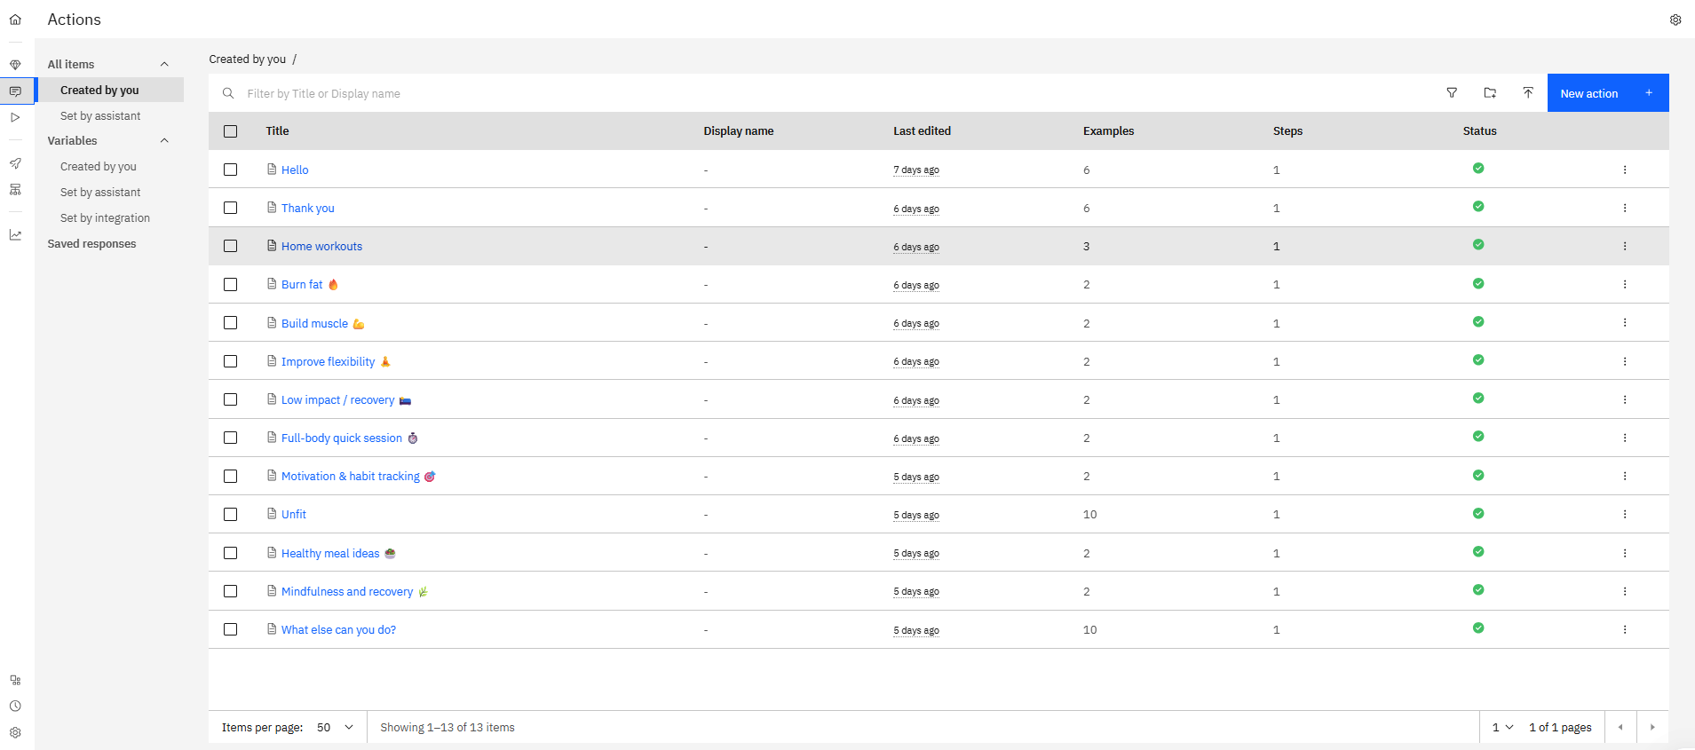

Slide 12
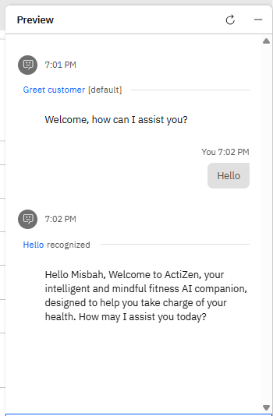
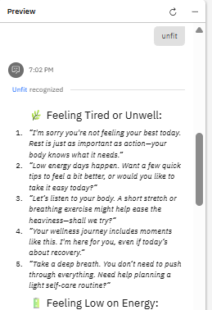
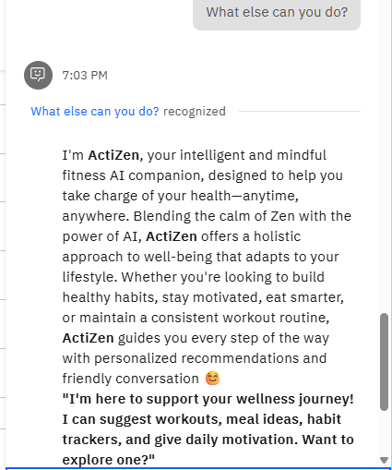
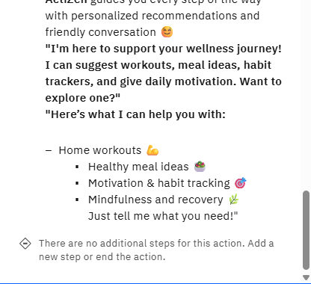

Slide 13
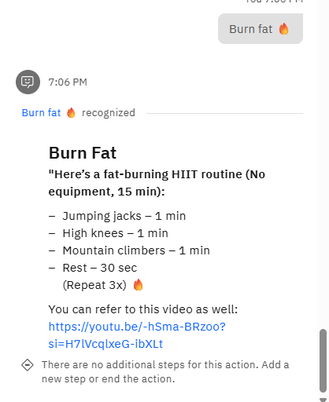
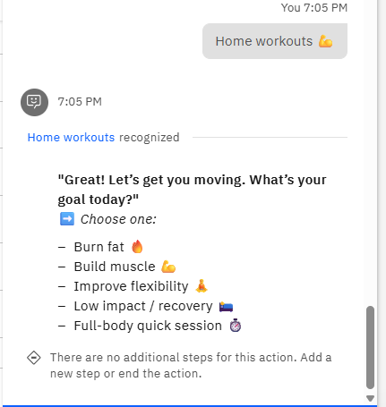
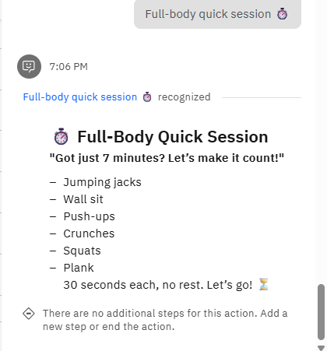

Slide 14
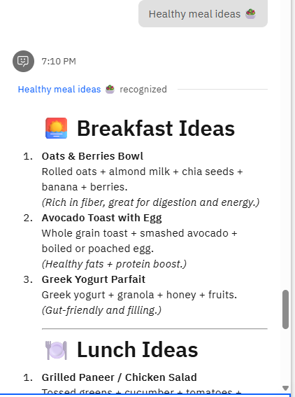
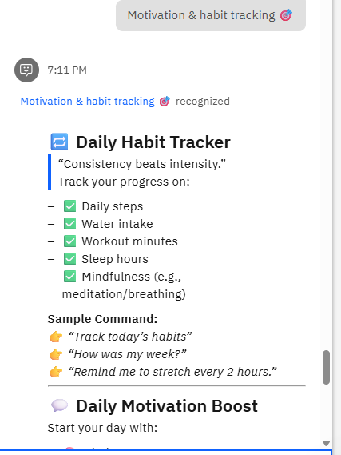
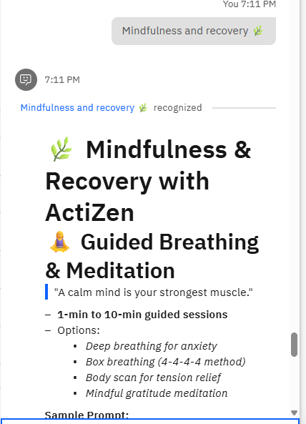

Slide 15
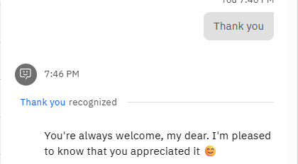

Slide 16
Conclusion & Future Scope
Challenges Faced
Future Scope
Limited real-time emotion data inputs.
Integration with wearables for real-time tracking.
Occasional mismatch in workout suggestions.
Difficulty in maintaining long-term engagement for some segments.
Advanced emotion detection (facial/voice analysis).
Expand multilingual support and accessibility.
Key Learnings
Modular plug-and-play framework for user choice.
Small nudges enhance user retention.
Visualization of progress builds trust and motivation.

Slide 17
References
IBM Watson Assistant Documentation: https://cloud.ibm.com/docs/watson-assistant
IBM Cloud Lite Services: https://www.ibm.com/cloud/free
Physical Activity Guidelines: CDC - Physical Activity Basics
Global Recommendations on Physical Activity for Health: WHO Physical Activity Guidelines
Habit Formation and Behavioral Change Research: Duhigg, C. (2012). The Power of Habit.

Slide 18
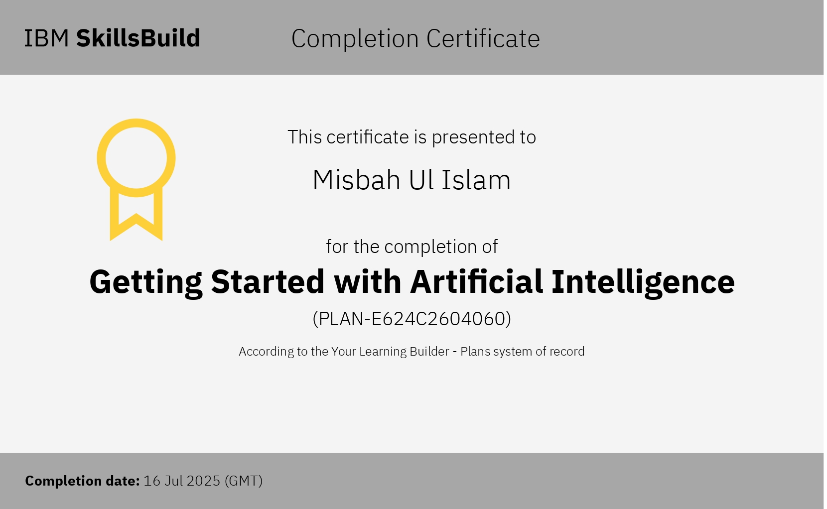
IBM Certifications

Slide 19
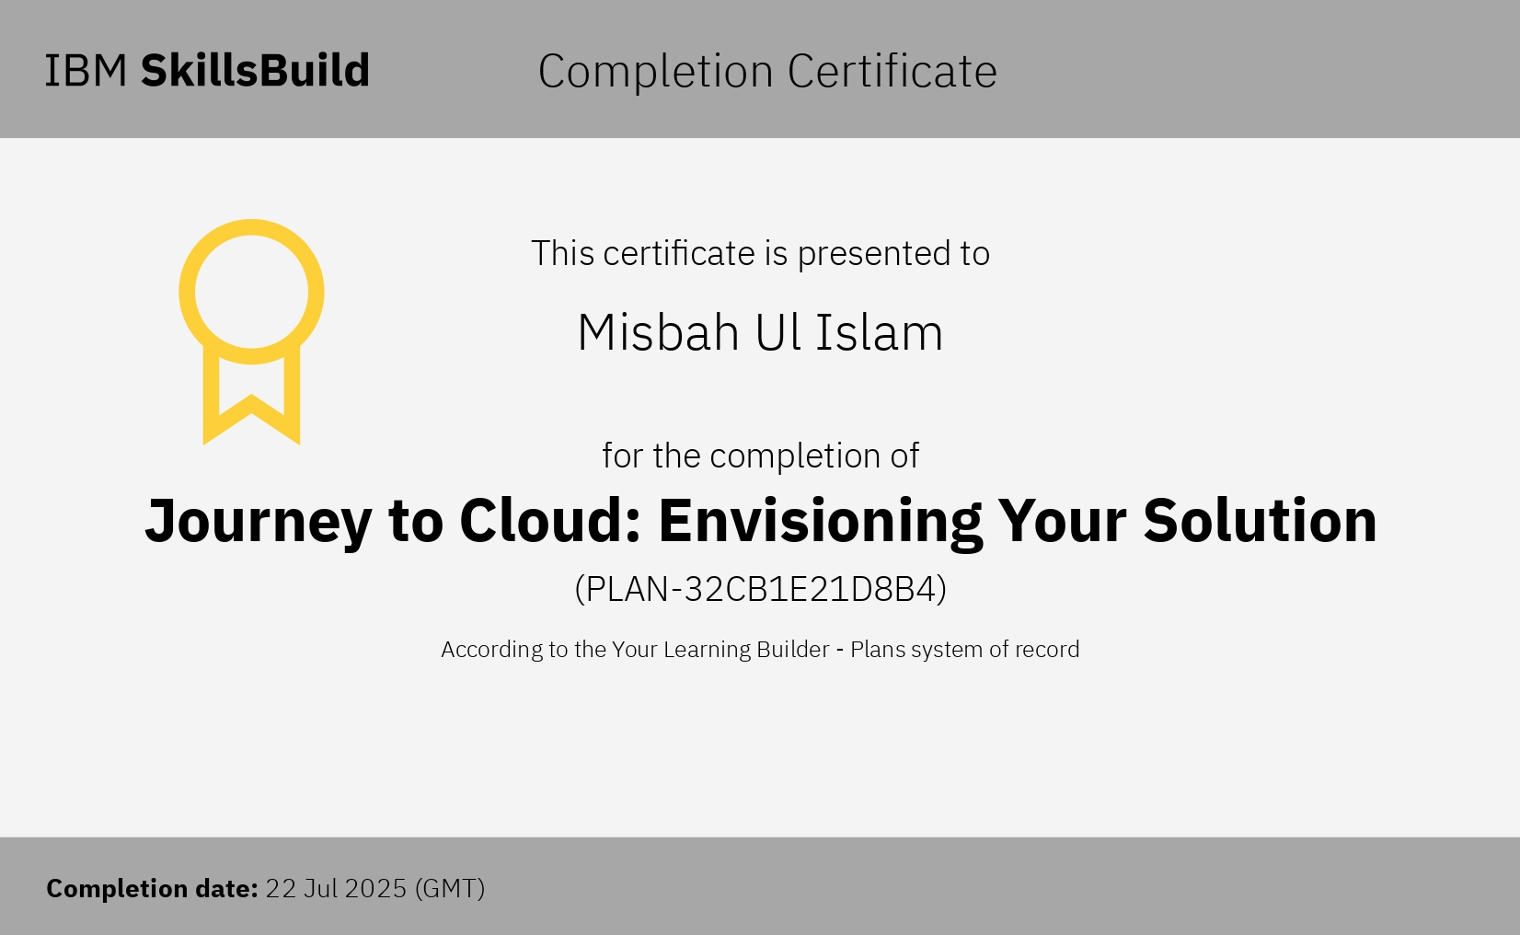
IBM Certifications

Slide 20
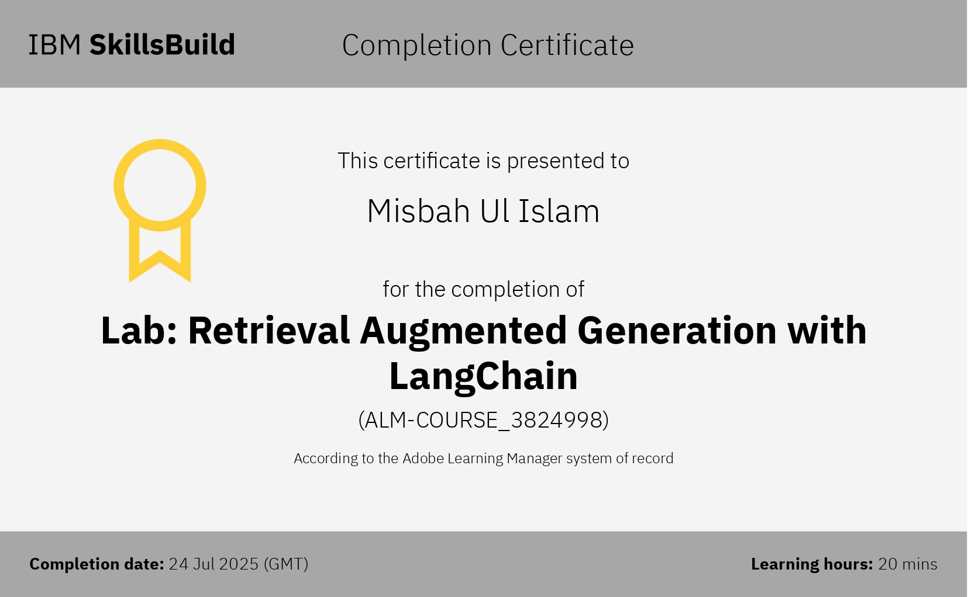
IBM Certifications

Slide 21
THANK YOU

